Slide 1
Bblr
Xavier de Gunten
David Spruill
Elder Yoshida

Slide 2
Trobleshooting
What went wrong?
Clogged check valves?
Circuit malfunction?
Bad solenoids?
Wrong combination of pressure, pulse width?
Uneven distribution of air?

Slide 3
Controlled Environment
Study different combinations of parameters
Setup
Air tank – uninterrupted airflow
Pressure gauge
Calibrate initial tank pressure & pump cutoff pressure
Read pressure with better precision

Slide 4
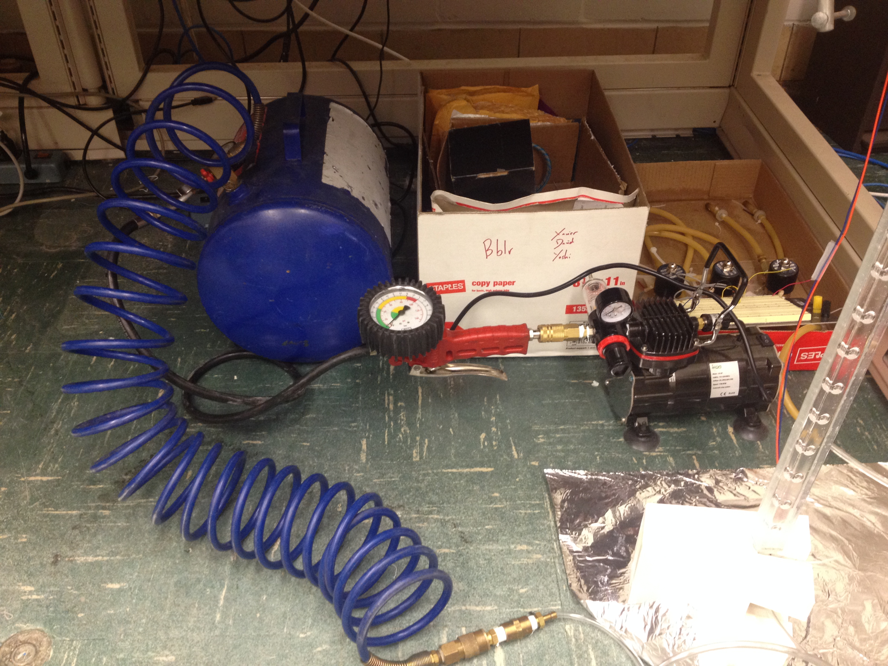
Setup
Air Tank
Pump
Pressure Gauge

Slide 5
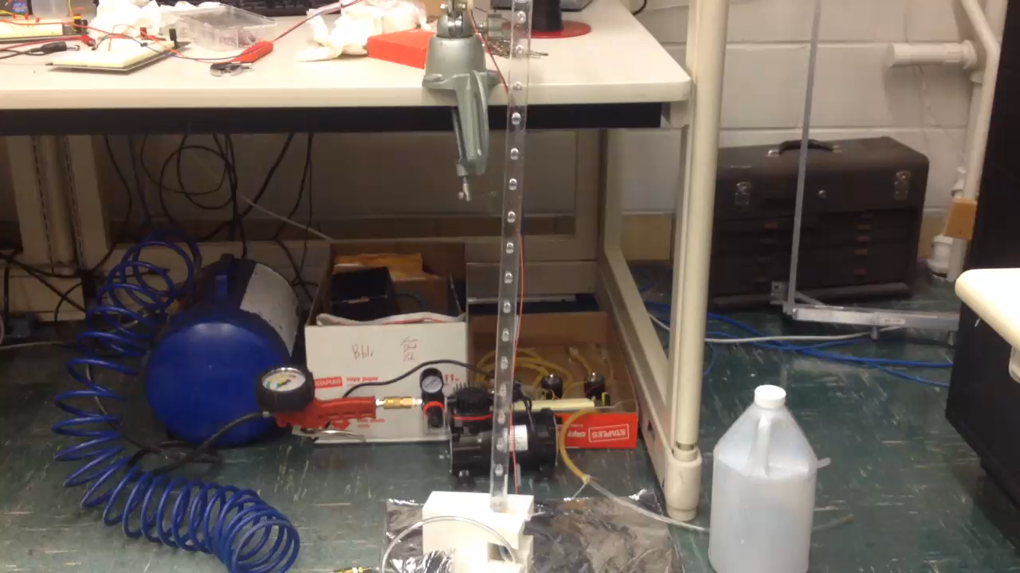
Huh? Problems are gone!

Slide 6
Results
Solenoid having trouble to hold pressure at 15psi
Small Bubbles coming up
~ 6.5ms too low to be consistent
Very consistent results for pressures below 12psi
12V solenoid input, 1Hz pulse frequency, pulse width >7.8ms

Slide 7
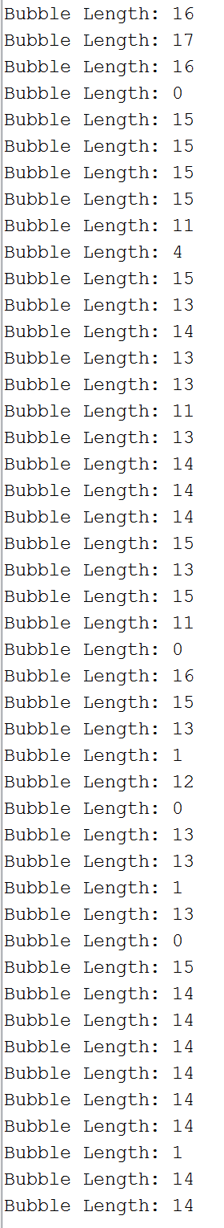
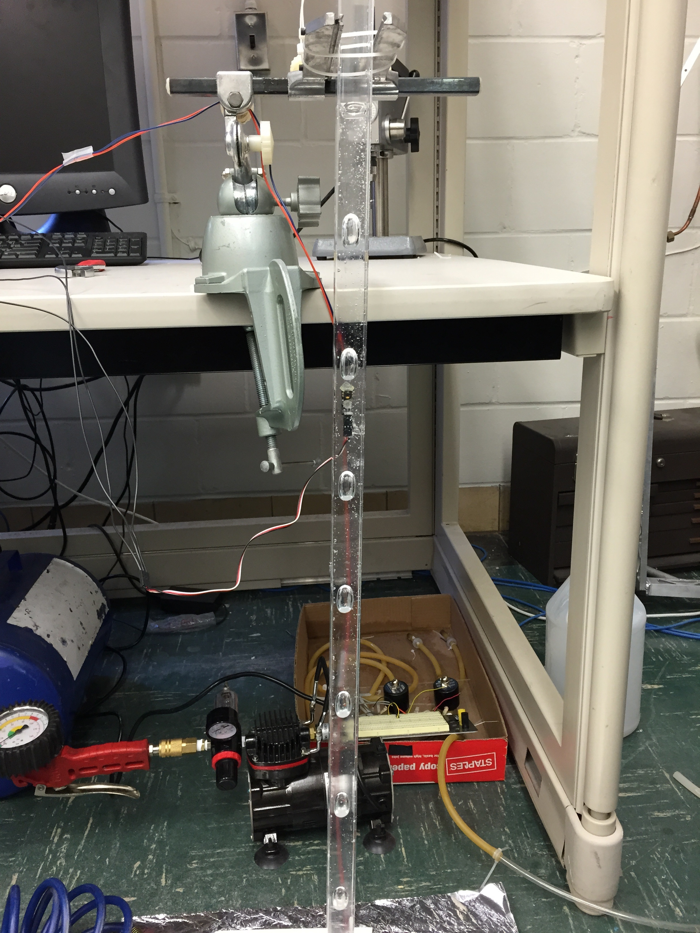
Bubble Detection

Slide 8
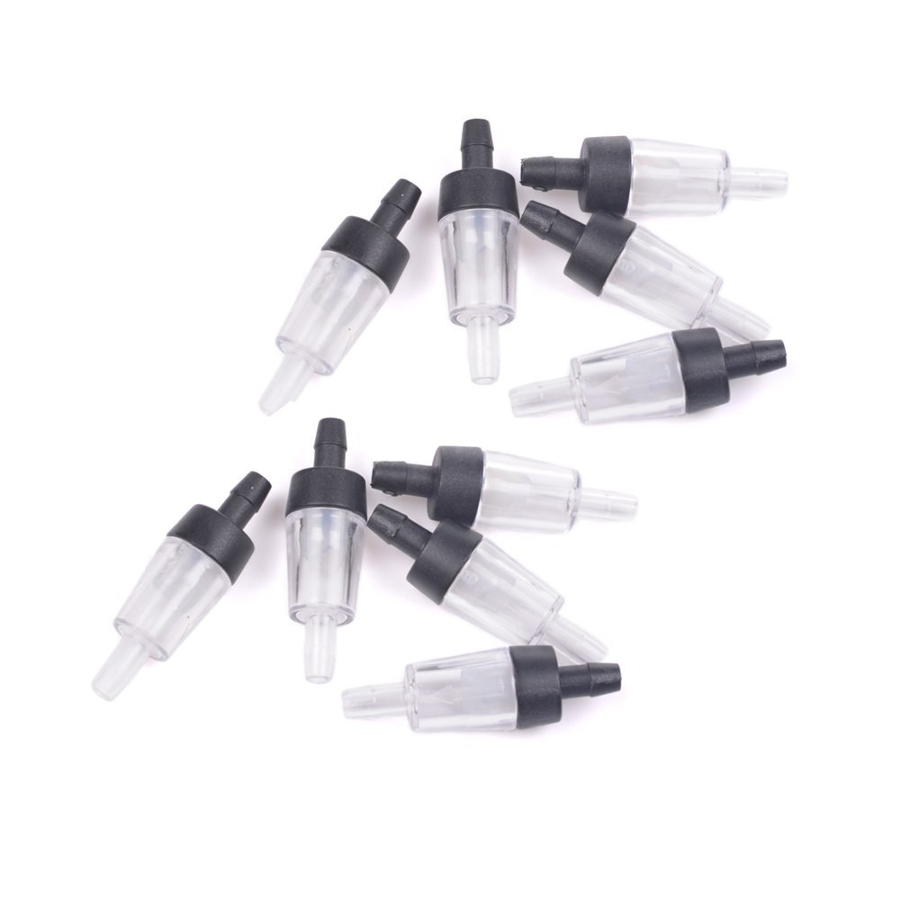
Bought new Check Valves
$6.49 for 10 units

